Slide 1


Carlos Guzman
12-30-2023

Slide 2

Outline
Executive Summary
Introduction
Methodology
Results
Conclusion
Appendix

Slide 3
Executive Summary
Summary of methodologies
Data Collection with API and via Web Scrapping
Data Wrangling
EDA with SQL, Python and Data Visualization
Interactive Map Visualization with Folium
Interactive Dashboard with Dash and Plotly
Predictive Analysis with Machine Learning
Summary of all results
EDA summary of results
Interactive analytics via Visualizations
Predictive Analysis with Machine Learning

Slide 4
Introduction
Summary of methodologies​
SpaceX advertises Falcon 9 rocket launches on its website with a cost of 62 million dollars; other providers cost upward of 165 million dollars each, much of the savings is because SpaceX can reuse the first stage. Therefore if we can determine if the first stage will land, we can determine the cost of a launch.​
Summary of all results​
Objective is to predict if the Falcon 9 first stage will land successfully.

Slide 5

Section 1

Slide 6
Methodology
Executive Summary
Data collection methodology:
Via SpaceX REST API
Web Scrapping with BeautifulSoup from Wikipedia
Perform data wrangling
Replaced missing values with mean, and 0 for non-relevant fields, one hot encoding for data normalization
Perform exploratory data analysis (EDA) using Data Visualization and SQL
Perform interactive visual analytics using Folium and Plotly Dash
Perform predictive analysis using machine learning with classification models
Data validation, Model building, and Model evaluation for Logistic Regression, Support Vector Machine, Decision Tree, and K-Nearest Neighbours

Slide 7
Data Collection
The data was collected using two methods in order to get an additional asset with more specific and also additional information to keep for further analysis:
Data collection of SpaceX Falcon 9 launch records was performed by making a get request to the SpaceX REST API and then extracting text data to store it into a pandas data frame.
Data collection of SpaceX for specific Falcon 9 launch records was performed by making web scraping to Wikipedia and then convert it to a pandas data frame.

Slide 8
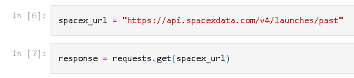
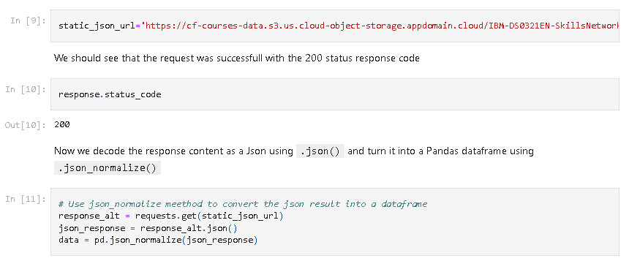
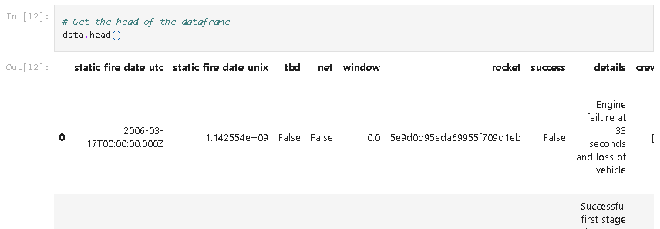
Data Collection – SpaceX API
Starting with the get request to the SpaceX REST API we get and check the response as well as status code.
The content response was decoded using .json() and .json_normalize() to convert it to a pandas data frame.
https://github.com/carloseguzf/Applied_Capstone-IBM_DS-SpaceX_Launches/blob/main/jupyter-labs-spacex-data-collection-api.ipynb

Slide 9
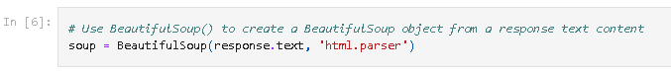
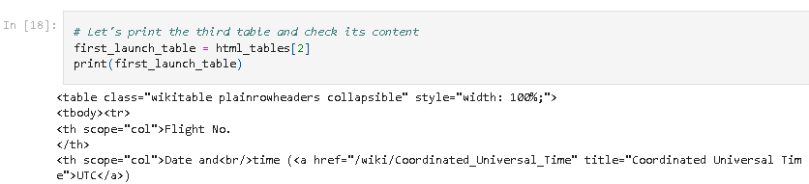
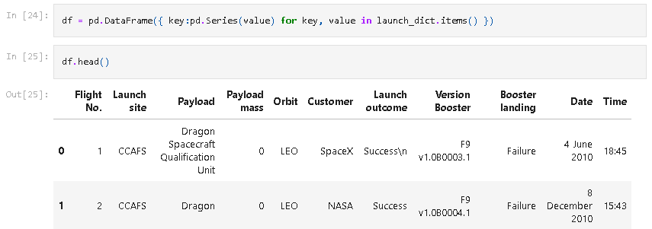
Data Collection - Scraping
Data was collected by applying web scrapping to Wikipedia using BeautifulSoup.
Data was parsed from tables and converted to a pandas data frame
https://github.com/carloseguzf/Applied_Capstone-IBM_DS-SpaceX_Launches/blob/main/jupyter-labs-webscraping.ipynb

Slide 10
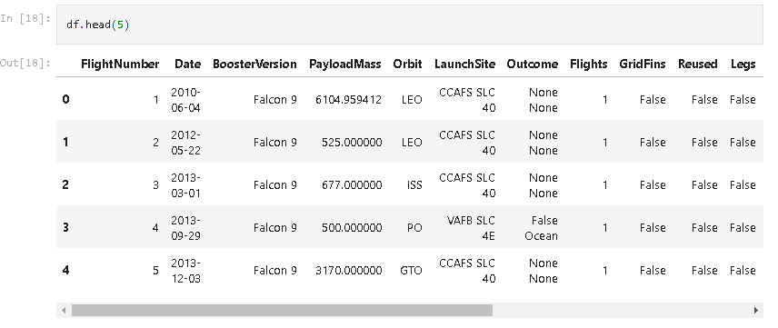
Data Wrangling
The exploratory data analysis was performed and dataset was cleaned using python and several libraries.
Data types were fixed to make them compatible with ML algorithms.
Null values were replaced.
The data was filtered to only preserve Falcon 9 launches.
Descriptive analysis to identify relevant features to calculate the dependent variable.
https://github.com/carloseguzf/Applied_Capstone-IBM_DS-SpaceX_Launches/blob/main/labs-jupyter-spacex-Data%20wrangling.ipynb

Slide 11
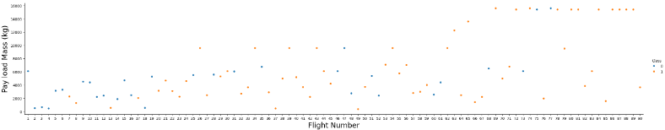
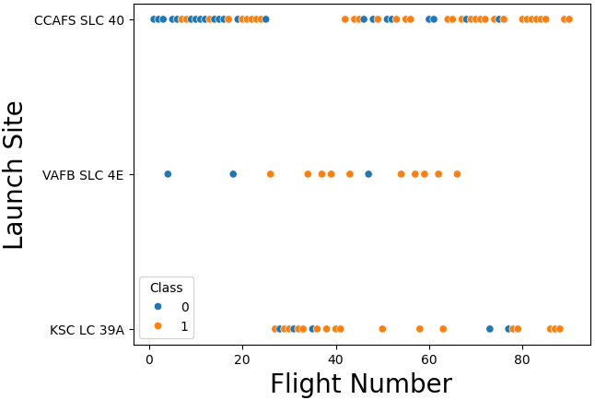
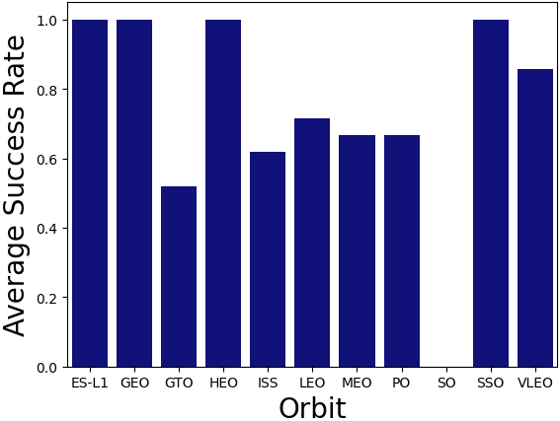
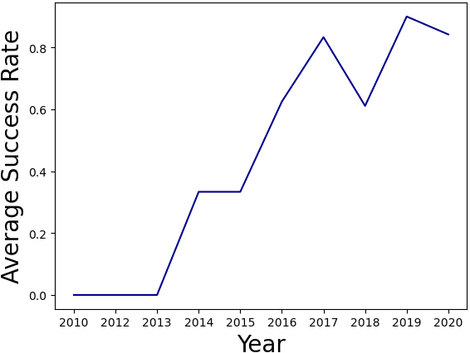
EDA with Data Visualization
Exploratory data analysis was performed by using data visualization with Matplotlib and Seaborn.
https://github.com/carloseguzf/Applied_Capstone-IBM_DS-SpaceX_Launches/blob/main/jupyter-labs-eda-dataviz.ipynb.jupyterlite.ipynb

Slide 12
EDA with SQL
Names of the unique launch sites in the space mission.
Total payload mass carried by boosters launched by NASA (CRS).
Average payload mass carried by booster version F9 v1.1.
Date when the first successful landing outcome in ground pad was achieved.
Names of boosters which have success in drone ship and have payload mass of 4000-6000.
Total number of successful and failure mission outcomes.
Names of booster_versions which have carried the maximum payload mass.
Rank the count of landing outcomes (such as Failure (drone ship) or Success (ground pad)) between the date 2010-06-04 and 2017-03-20, in descending order.
https://github.com/carloseguzf/Applied_Capstone-IBM_DS-SpaceX_Launches/blob/main/jupyter-labs-eda-sql-coursera_sqllite.ipynb

Slide 13
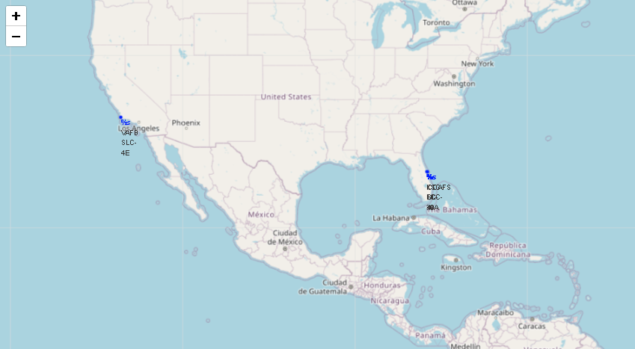
Build an Interactive Map with Folium
An interactive map was created using Folium in order to get insights about ideal locations for launch sites.
https://github.com/carloseguzf/Applied_Capstone-IBM_DS-SpaceX_Launches/blob/main/lab_jupyter_launch_site_location.jupyterlite.ipynb

Slide 14
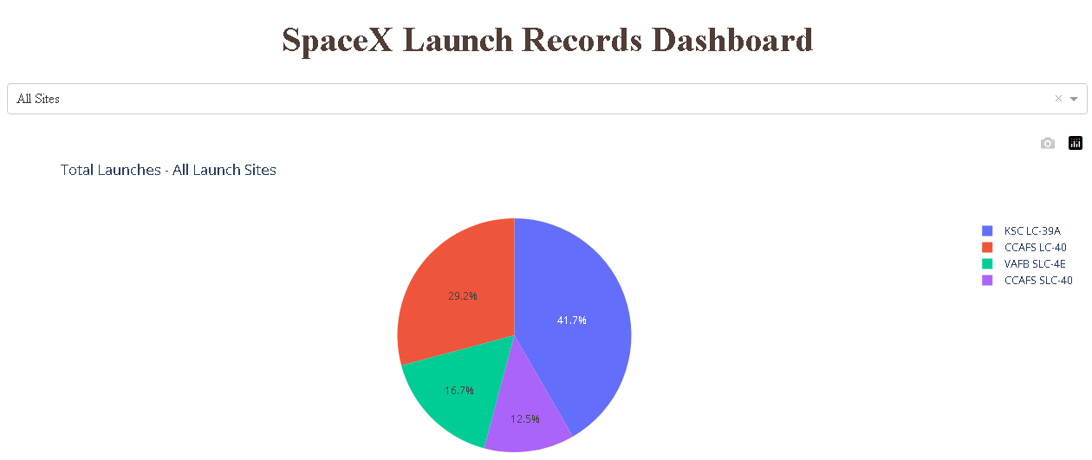
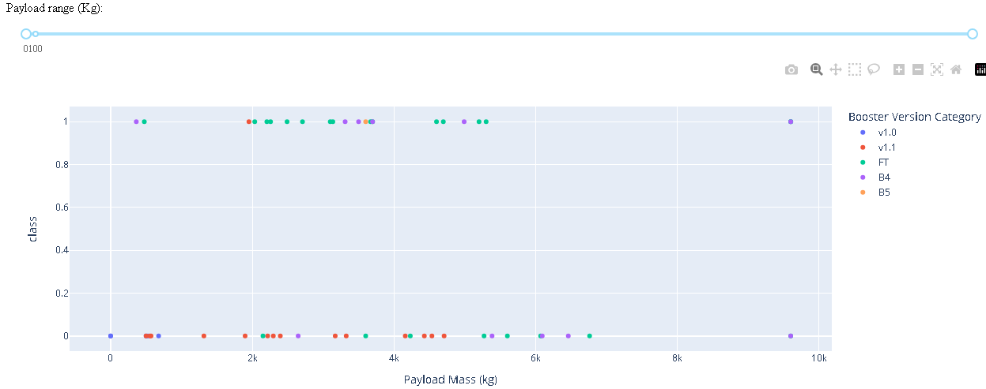
Build a Dashboard with Plotly Dash
A pie chart was created to show total launches for each launch site.
A scatter plot was created to show payload mass carried by each booster version and also to check if the landing was successful or not.
https://github.com/carloseguzf/Applied_Capstone-IBM_DS-SpaceX_Launches/blob/main/spacex_dash_app.py

Slide 15
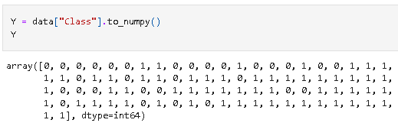
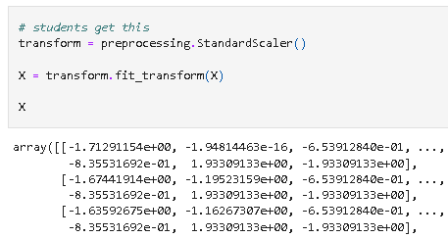
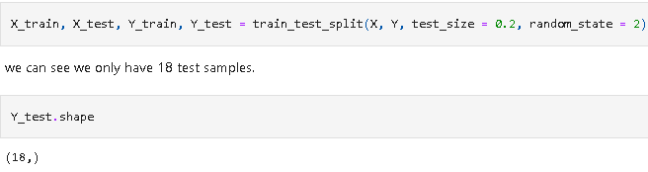
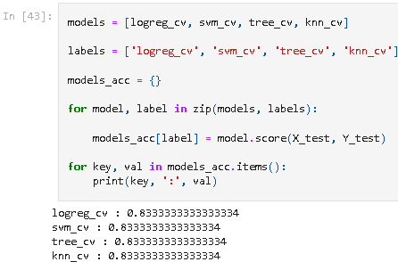
Predictive Analysis (Classification)
The dataset was normalized and dummy variable for dependent variable was created.
Columns were normalized and dataset was split into train and test datasets.
GridSearchCV models were used to find the best hyperparameters.
Created, trained and tested the models:
Logistic regression, Support Vector Machine, Decision Tree, K-Nearest Neighbours.
Performed Model Evaluation and compared models to get the model with highest accuracy.
https://github.com/carloseguzf/Applied_Capstone-IBM_DS-SpaceX_Launches/blob/main/SpaceX_Machine_Learning_Prediction_Part_5.jupyterlite.ipynb

Slide 16
Results
Exploratory data analysis results
Interactive analytics demo in screenshots
Predictive analysis results

Slide 17

Section 2

Slide 18
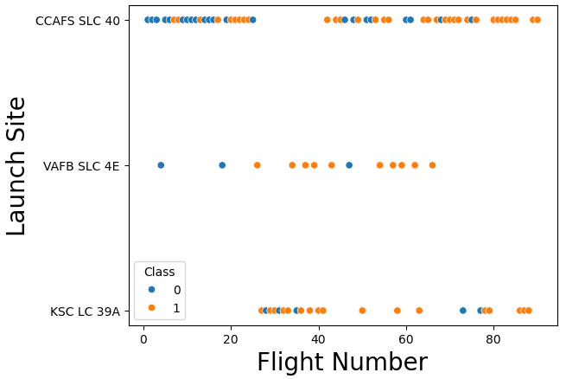
Flight Number vs. Launch Site
CCAFS SLC-40 has the majority number of launches.
It seems that KSC LC39A has many successful landings.

Slide 19
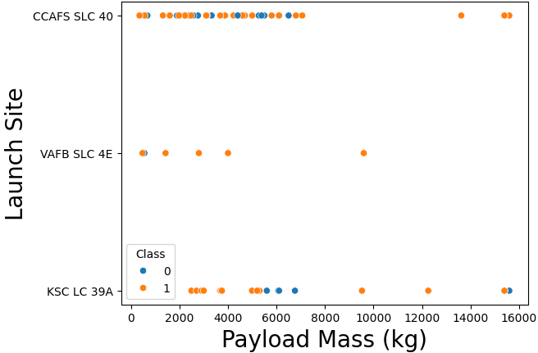
Payload vs. Launch Site
CCAFS SLC-40 has the majority of its flights with lower payload mass.
VAFB SLC-4E doesn't have flights for higher payload mass.
KSC LC-39A has the majority of successful landings for higher payload mass.

Slide 20
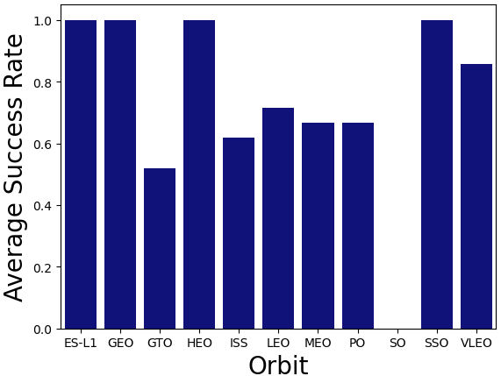
Success Rate vs. Orbit Type
ES-L1, GEO, HEO, SSO, and VLEO have the higher success rate of landings.
SO shows a lower success rate of landings or not enough flights to calculate an accurate result.

Slide 21
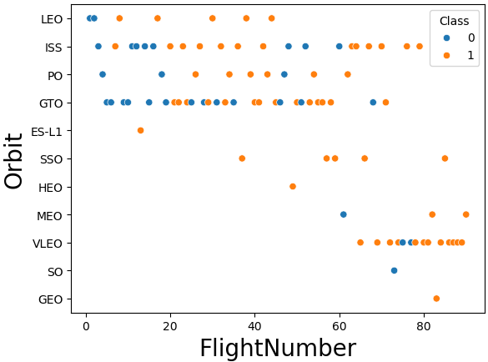
Flight Number vs. Orbit Type
LEO, ISS, PO, and GTO have the higher count of flights.
VLEO seems to have the higher count of flights and a considerable amount of them are successful.

Slide 22
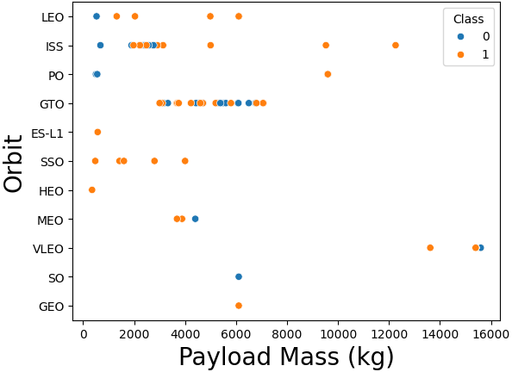
Payload vs. Orbit Type
ISS, and GTO seems to be correlated to lower payload mass amounts.
Ther amount of payload mass seems to variate for the rest of the orbits showing no correlation at all.

Slide 23

Launch Success Yearly Trend
Since 2013 the success rate of landings increased.
In 2015 increased again to a higher success rate.
In 2020 it decreased.

Slide 24
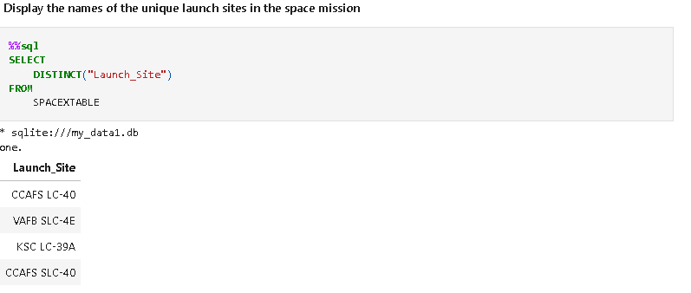
All Launch Site Names

Slide 25
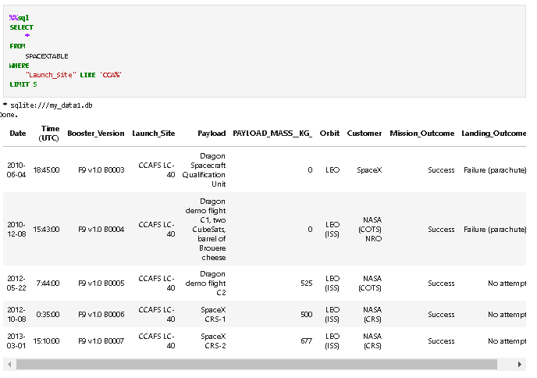
Launch Site Names Begin with 'CCA'

Slide 26
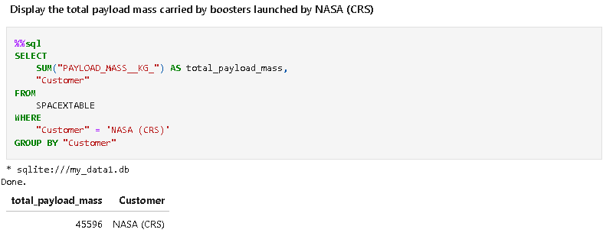
Total Payload Mass

Slide 27
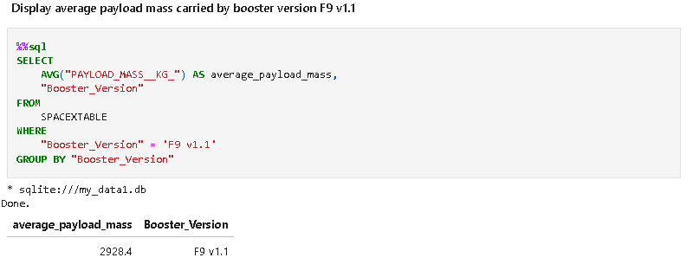
Average Payload Mass by F9 v1.1

Slide 28
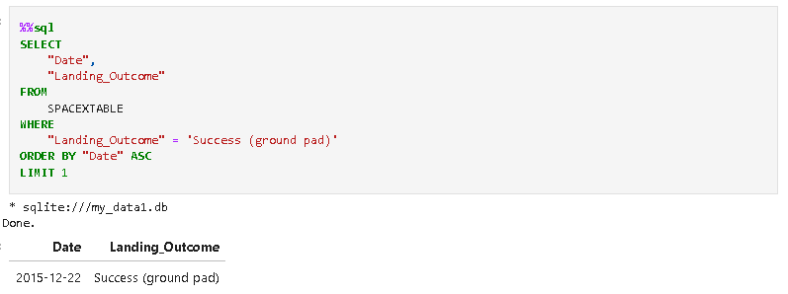
First Successful Ground Landing Date

Slide 29
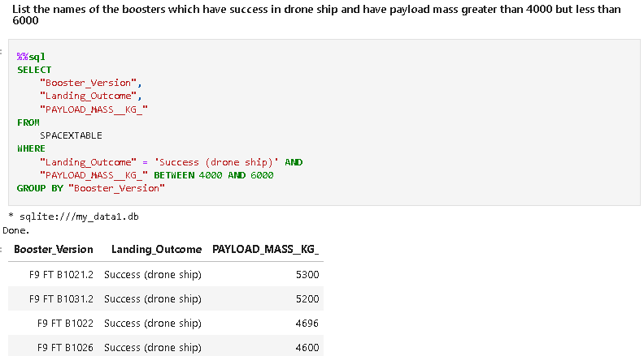
Successful Drone Ship Landing with Payload between 4000 and 6000

Slide 30
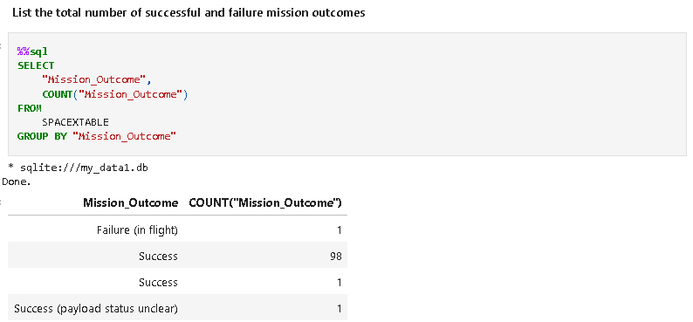
Total Number of Successful and Failure Mission Outcomes

Slide 31
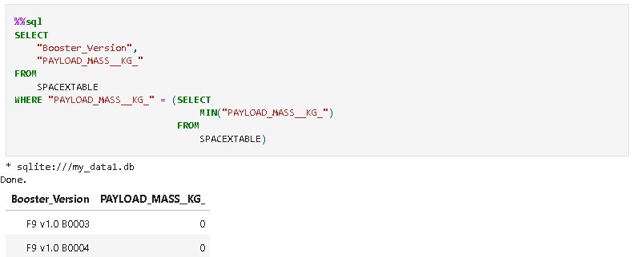
Boosters Carried Maximum Payload

Slide 32
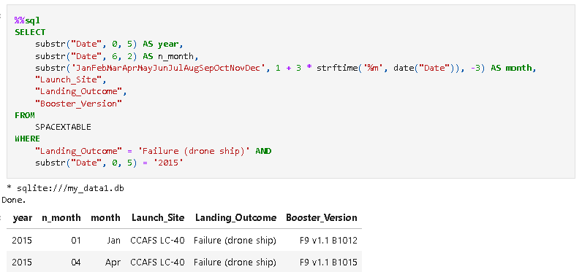
2015 Launch Records

Slide 33
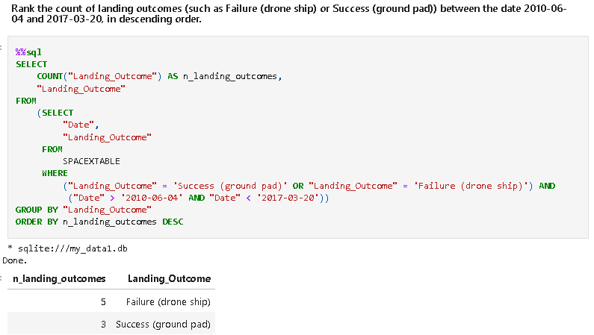
Rank Landing Outcomes Between 2010-06-04 and 2017-03-20

Slide 34

Section 3

Slide 35
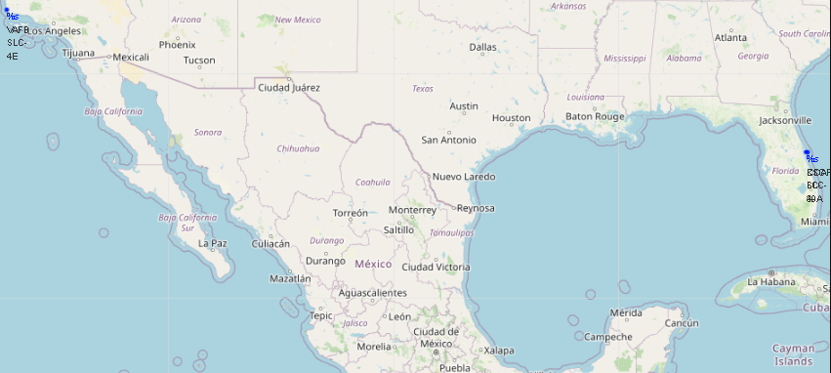
Launch Sites Locations
All launch sites in very proximity to the coast.
Launch sites have certain proximity to the Equator line.

Slide 36
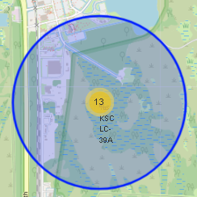
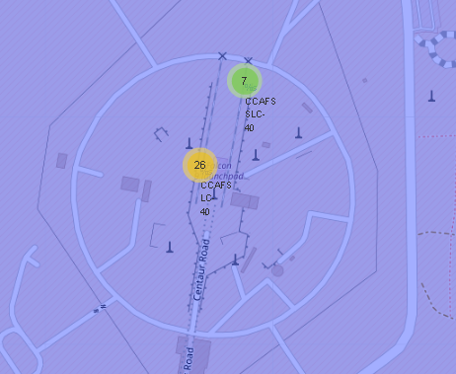
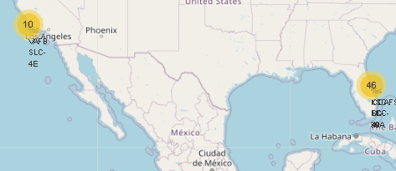
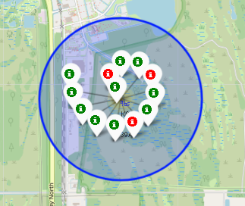
Count of Successful/Unsuccessful Landing Outcomes for each Launch Site
Count of launches labeled by successful or unsuccessful landing for each launch site.
KCS LC-39A has the greater number of successful launches.

Slide 37
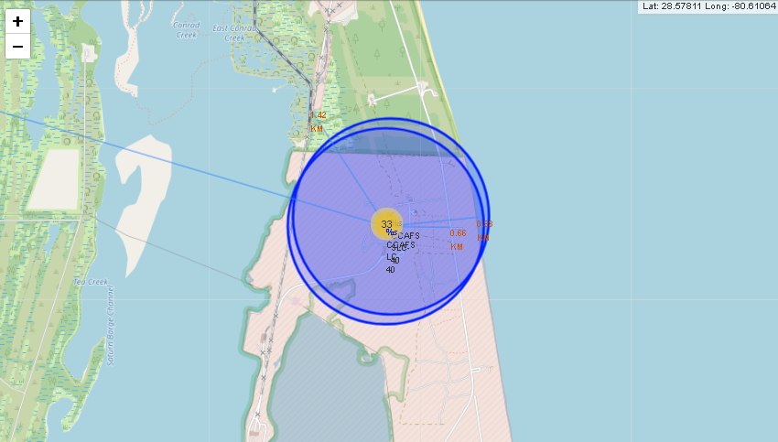
Launch Sites Proximities
CCAFS SLC-40 is the Launch Site that is nearest to a railway, highway, and city than the others.

Slide 38

Section 4

Slide 39
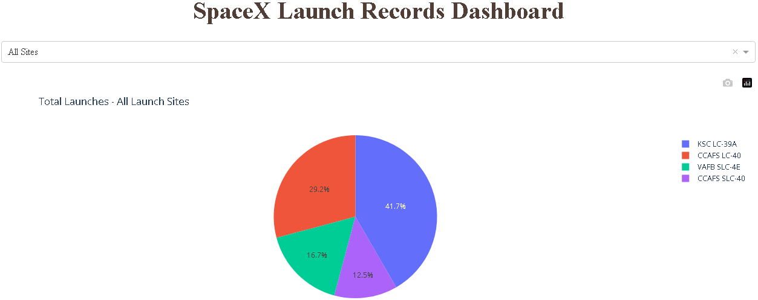
Total Launches by Launch Site
Counts of launches for each site are compared.
KSC LC-39A launch site has the majority of the total launches.

Slide 40
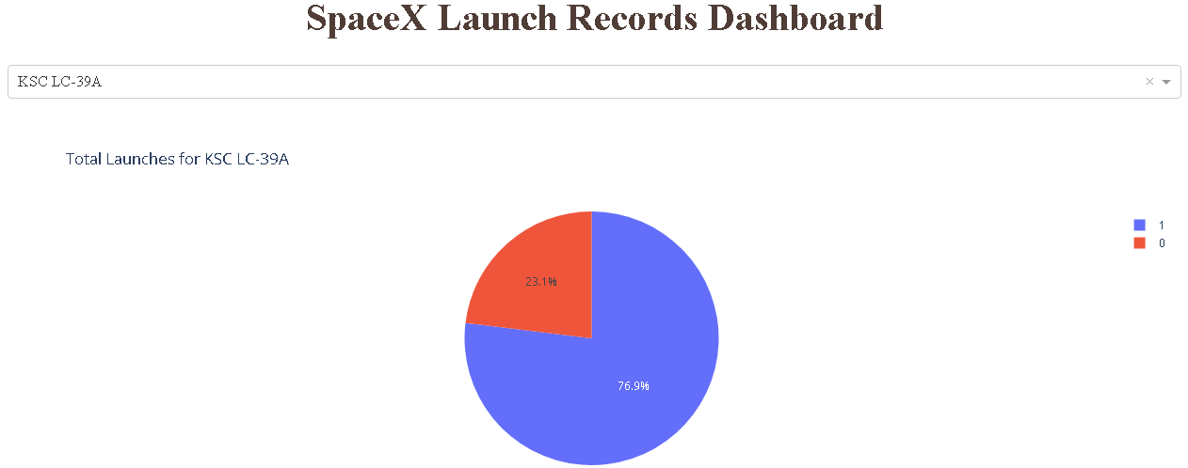
Launch Site with the Majority of Successful Launches
KSC LC-39A has the greater ratio of successful launches.

Slide 41
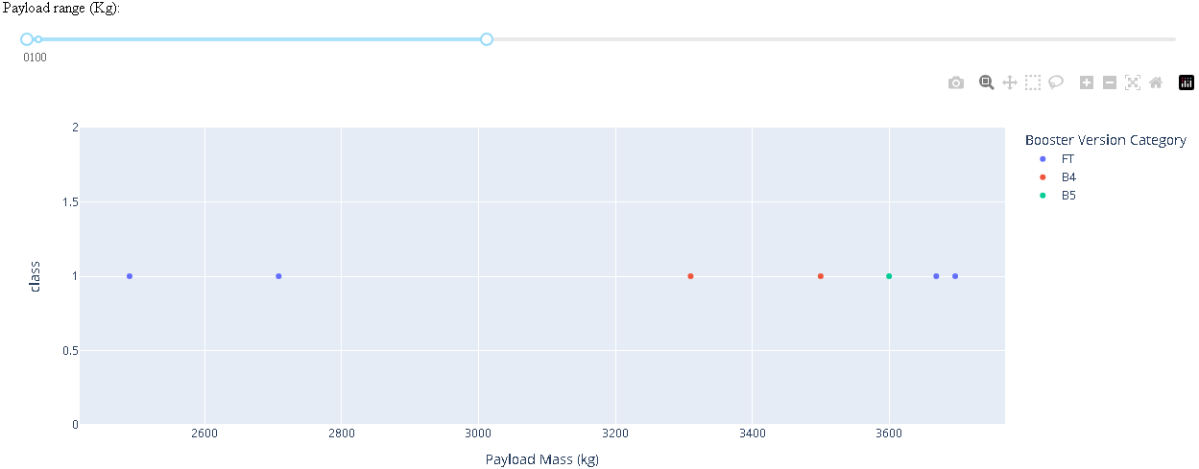
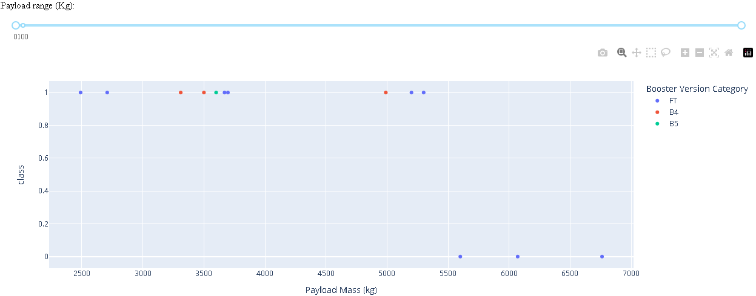
Payload Mass Carried by Boosters
FT Booster Version Category has the majority of successful launches for medium and high amount of payload mass.

Slide 42

Section 5

Slide 43
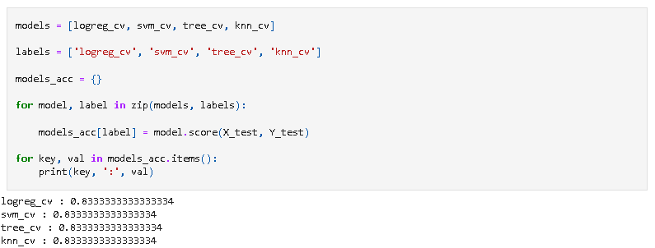
Classification Accuracy
All created models have shown almost the same accuracy, however for the purposes of this dataset, decision trees or logistic regression may be a good fit.

Slide 44
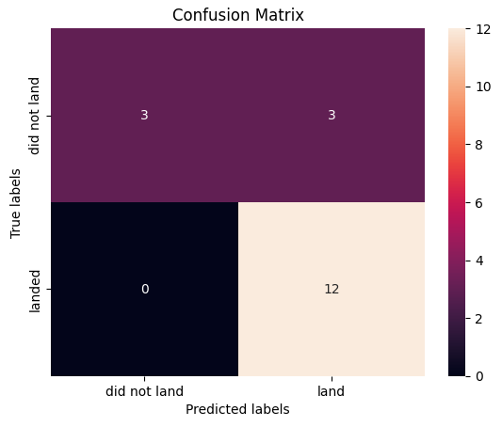
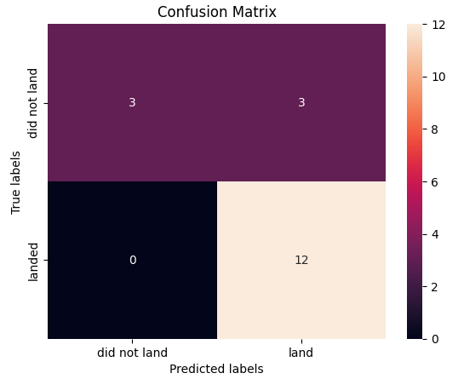
Confusion Matrix
All models are showing strong accuracy for predicting successful outcomes, the consistent problem is with the False Positives.

Slide 45
Conclusions
Launches with payload mass higher than 10000 have a low success rate of landing.
ES-L1, GEO, HEO, SSO, and VLEO Orbits have the higher success rate of landings.
KSC LC-39A Launch Site has the majority count of successful landings.
Almost all launch sites are near to the coast, railway, and relatively near cities depending on launch site's location.
The best models determined by an accuracy of 83% and the characteristics of the dataset are Logistic Regression and K-Nearest Neighbours, also Support Vector Machines can be used for the predictive analysis.
Yearly trend success rate shows that probably improvements on technology, lessons learned and trial and error are shaping the way to get a 100% success rate of landing in the future, as more data on those launches is generated, better models can be created.

Slide 46
Appendix
Material, Notebooks, Python Code and Datasets used for analysis can be found on a github's repository in the following link:
https://github.com/carloseguzf/Applied_Capstone-IBM_DS-SpaceX_Launches

Slide 47


